Slide 1

Hospital Analytics Dashboard
Integrated insights from patient activity, doctor performance, inventory, finances, and operational capacity

Slide 2
Executive Overview
30
15
$714K
3,928
Total Patients
Doctors
Total Revenue
Medicines Sold
Moderate volume with steady monthly flow
Sufficient staffing for medium-size facility
Strong performance from surgeries and rooms
High volume but low revenue capture
The hospital demonstrates stable operations with strong surgical revenue, but faces challenges in diagnostic utilization, ICU capacity, inventory management, and doctor workload distribution.

Slide 3

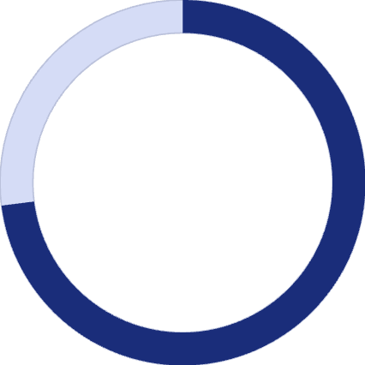
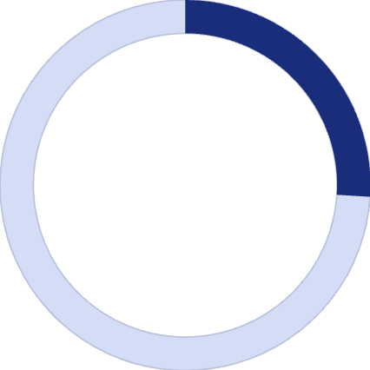
Patient Demographics & Flow
Age Distribution and Clinical Patterns
31-45 years (14 patients): Largest group, common chronic conditions (diabetes, hypertension). Drives outpatient visits and prescription demand.
46-60 years (10 patients): More advanced chronic diseases, requiring specialist consults and diagnostic services.
Under 30 & Over 60 (6 combined): Smaller cohort, requires specialized care (pediatric/trauma for <30, geriatric for >60 with complex needs).
80% of patients are 31-60 years old, driving high demand for specific medications (insulin, amlodipine, metformin) and impacting pharmacy inventory.
Discharge and Admission Dynamics
73%
Discharge Rate
Efficient throughput, optimizing bed utilization.
26%
Admission Rate
8 out of 30 patients require inpatient care, impacting bed capacity and staff allocation.
Seasonal Surge in August: A peak of 11 discharges highlights a seasonal surge, requiring dynamic staff allocation and pre-stocking of critical medicines.

Slide 4

Doctor Workload Imbalance
Uneven Distribution
High Dependency Risk
35 total appointments average only 2.3 per doctor, revealing significant workload imbalance across specialties.
2-3 doctors generate majority of revenue. If one specialist becomes unavailable, both revenue and patient throughput drop sharply.
Capacity Underutilization
Some doctors show low appointment frequency while high-demand specialists are overloaded, increasing wait times.

Slide 5
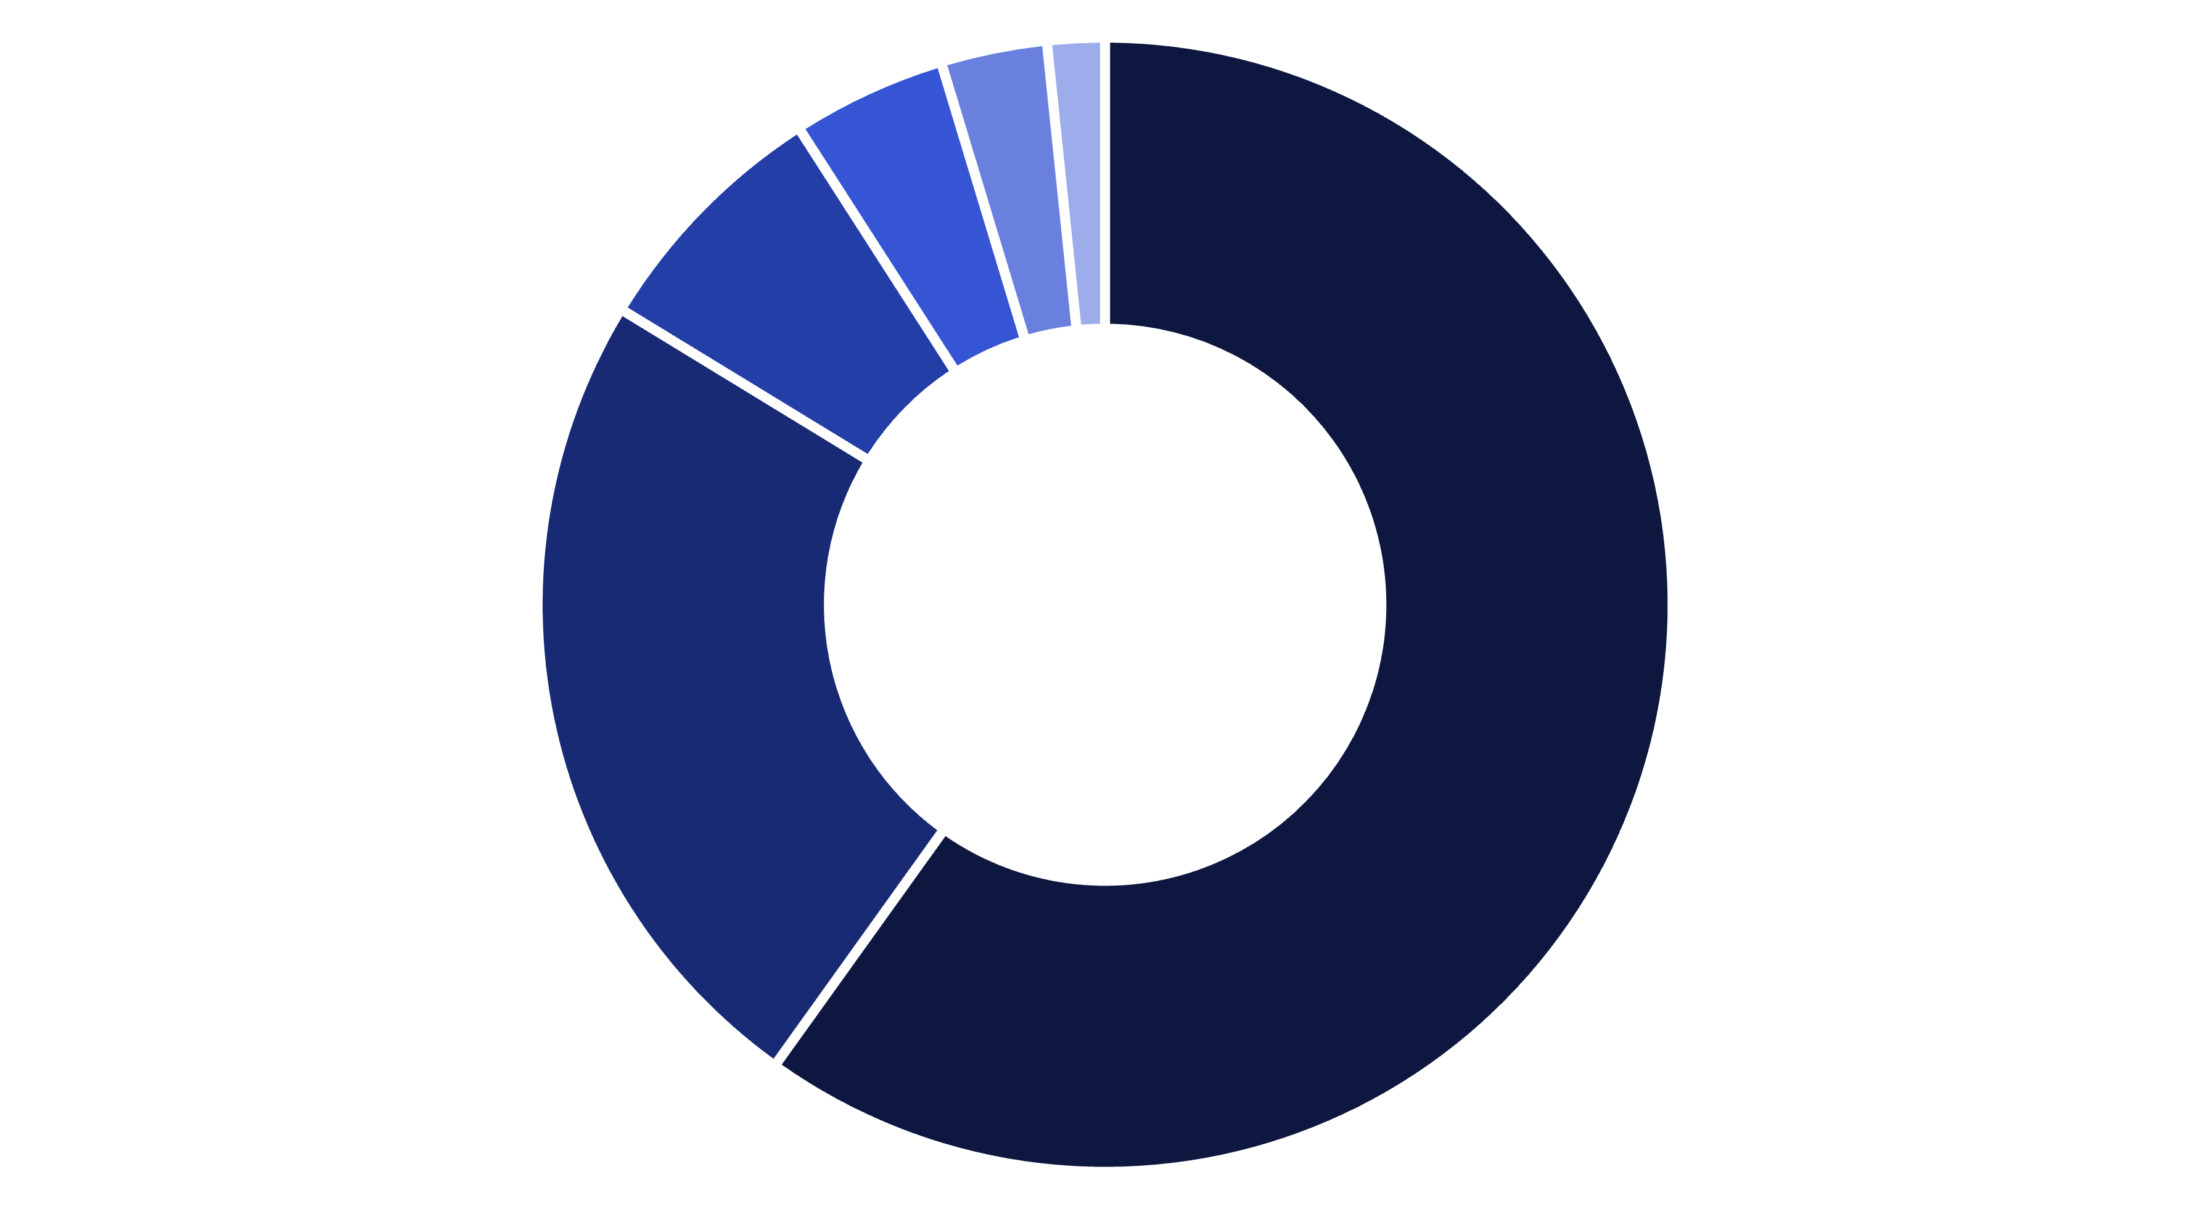
Revenue Breakdown
Surgery
Room Charges
Tests
Other Fees
Discounts
Medicine
Critical Finding: Diagnostics contribute only 7% of revenue despite typically representing 25-35% in comparable facilities. Medicine revenue at $10K is disproportionately low for 3,928 units sold, indicating major revenue leakage.

Slide 6

The Hidden Revenue Leakage
Diagnostic Underutilization
Pharmacy Revenue Loss
Only $50K from tests — should be $120K+ based on patient volume and industry standards.
$10K from 3,928 units means patients buy medicines externally. Recovering 50% could boost monthly revenue by 30-40%.
Surgery Dependency Risk
60% of revenue from surgeries creates volatility. If surgical volume drops, overall revenue collapses.

Slide 7
Critical Inventory Challenges
Stock Status Alert
Peak Demand: June saw 900 units sold, while May dropped to 450 units. Consistent demand of 500-700 units across July-October.
15%
Insulin stockouts pose serious clinical risk for diabetic emergencies. Overstock of slow-moving drugs freezes working capital and reduces investment capacity for high-demand medicines.
Insulin
Critical shortage risk
20%
Ibuprofen
High-demand painkiller low
55%
Amlodipine
Stable, reorder soon
80%
Diazepam
Controlled, adequate stock

Slide 8
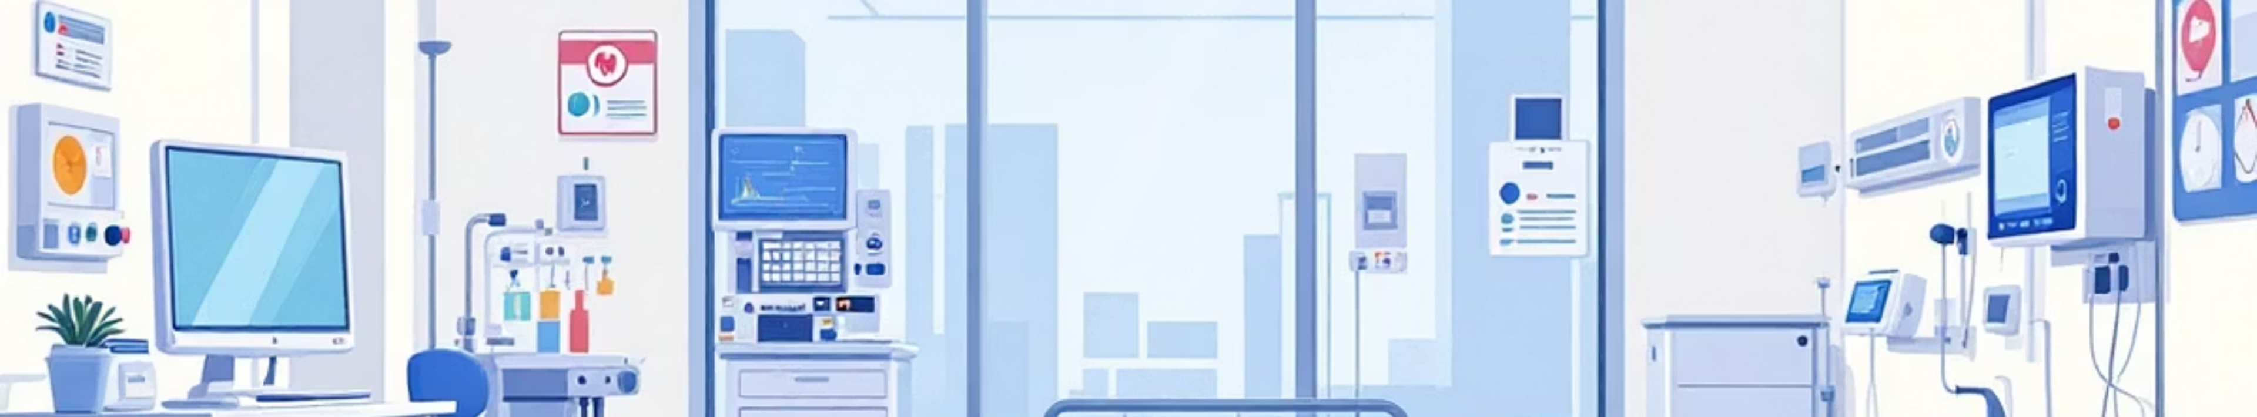

Bed Capacity Crisis
General Beds
ICU Overcapacity
Private Rooms
5 available, 4 occupied — Balanced utilization with minimal risk of capacity constraints.
4 available, 5 occupied — Critical alert. Limits acceptance of emergency cases and impacts patient outcomes.
4 available, 0 occupied — Underutilized premium rooms represent significant missed revenue opportunity.

Slide 9



Strategic Action Plan
Revenue Growth
Increase diagnostics: $50K → $120K via mandatory pre-op tests
Boost pharmacy: $10K → $50K through in-hospital dispensing
Improve private room occupancy: 0% → 40%
Resource Optimization
Convert 2 general beds to ICU beds
Reduce overstock of slow-moving drugs by 25%
Optimize doctor scheduling for 20% wait time reduction
Patient Experience
Target 4.5+ rating across all departments
Achieve zero critical medicine stockouts
Implement automated appointment reminders

Slide 10
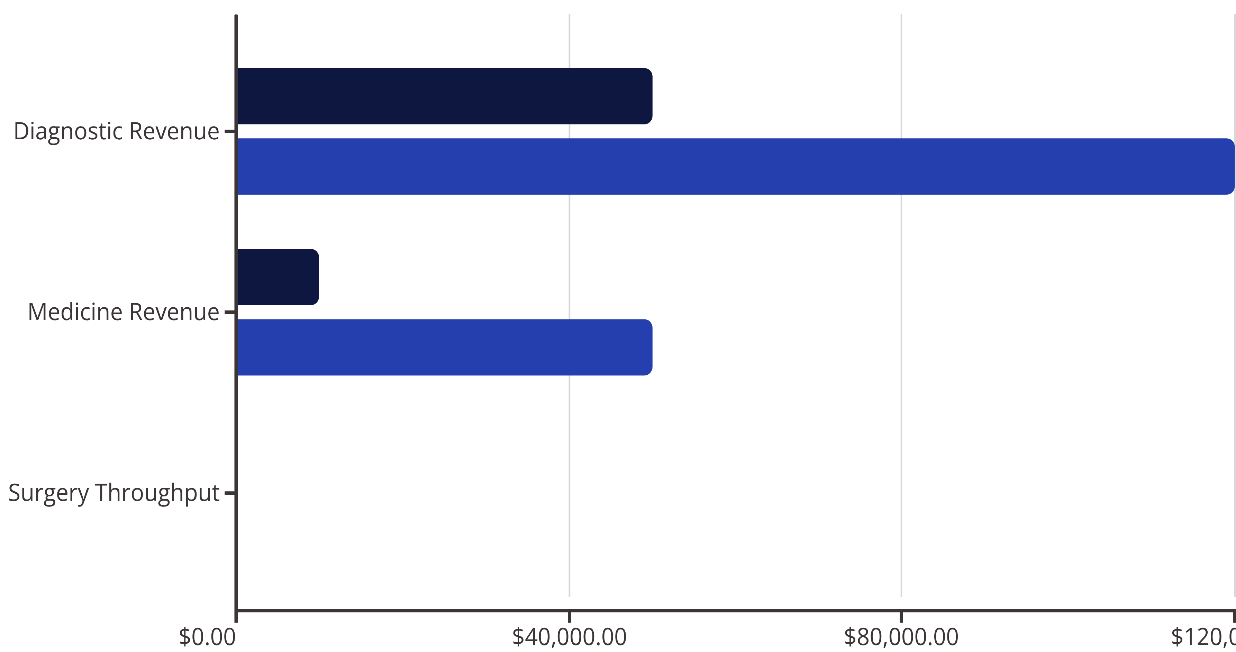
Future Growth Targets
Current
Target
Implementing these improvements will enhance operational efficiency, increase revenue by 40-50%, and improve patient satisfaction. Focus areas: real-time data integration, predictive demand modeling, automated stock alerts, and comprehensive patient profiling.

